Slide 1
Video-Med
By Juancarlos

Slide 3
My Goals
1- To Improve patients care outcomes
2- Reduce Cost
3- Educate Patient and provide experience
4- Deliver much more than a video conferencing
5- Delivering remote video consulting
6- Integrated medical devices
7- Easy to use for all patients

Slide 4
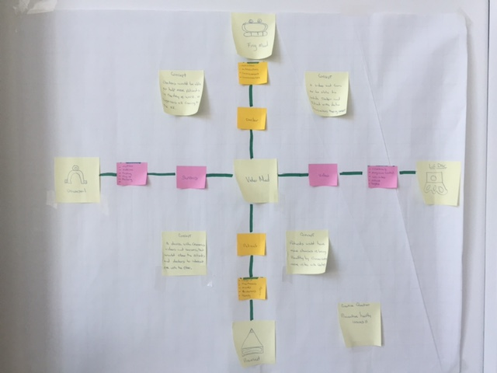
Purpose
My purpose is to share via remote patient monitoring in one system with clinician. The device will include automatic video call routing by service with EKG and EMG sensors to process the electrical activity of the heart.

Slide 5
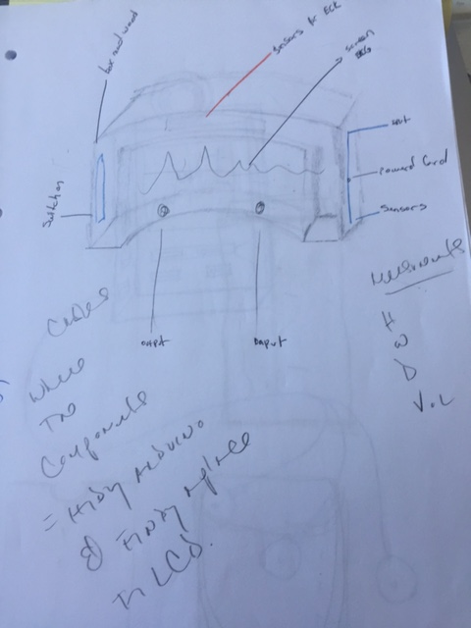
Visualize Concept
This is my original concept a screen in the center of the device with all the input sensors on the outside

Slide 6
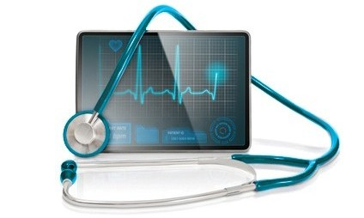
Form
This was my form and idea behind of the video-med

Slide 7
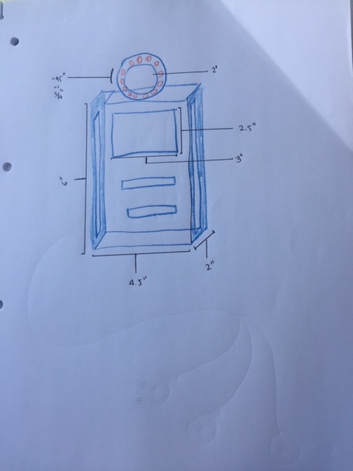
Dimensions
All the dimensions are in inches. I started with the height 6” , depth 2” width 4.5”, screen width 3” and a height 2.5”

Slide 8
Video-Med
Consist of the followings:
Capacitive Touch Sensors as input
An Actuator as output
An Arduino
An Olimexino 328
Communication Network Protocol

Slide 9
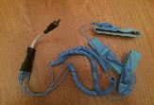
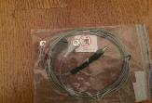
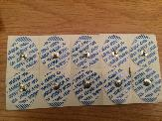
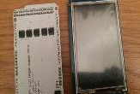
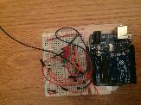
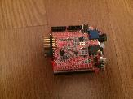
Materials
Shield EKG
Shield EMG
Electrode Monitoring medi frace foam
3.2 TFT LCD Touch Screen
Arduino uno
Olimex Board

Slide 10
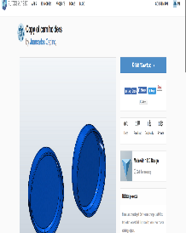
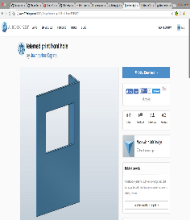
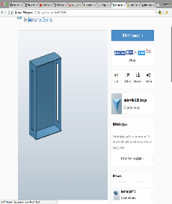
Modeling 3D

Slide 11
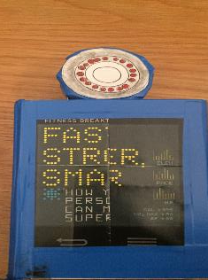
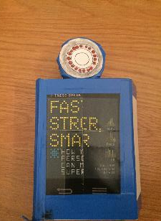
Prototype

Slide 12
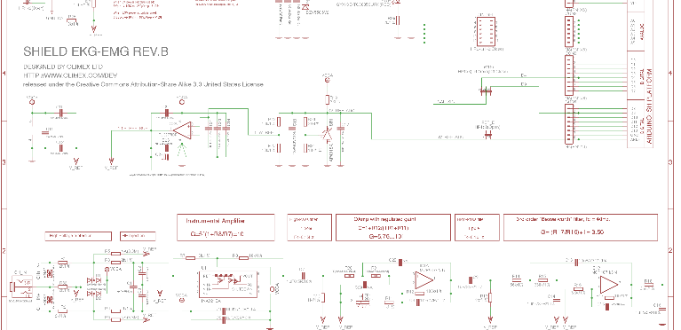
Schematic for Olimexino 328

Slide 13
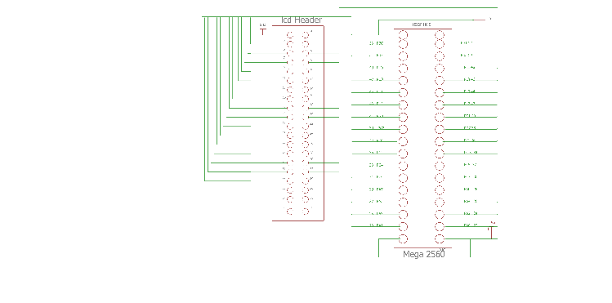
LCD and Arduino Schematic

Slide 14
Olimexino Shield with Arduino Schematic

Slide 15
Pseudo Code

Slide 16
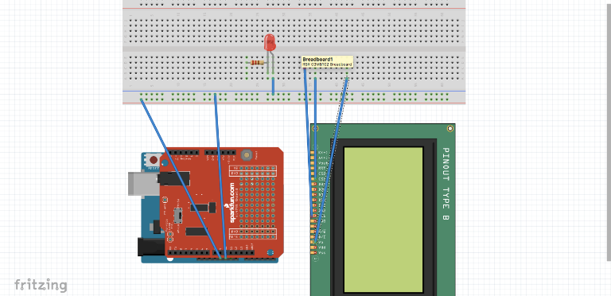
Breadboard + arduino + Olimexino328 and a 3.2 LCD screen

